Slide 1


Time-Optimized Contextual Information Flow on Unmanned Vehicles
K. PanagidI, I. Galanis, C. Anagnostopoulos and S. Hadjiefthymiades
WiMob 2018
The 14th International Conference on Wireless and Mobile Computing, Networking and Communications.

Slide 2
Contents
Introduction
Problem Definition
Change Point Theory Contribution
Performance Evaluation
Conclusions and Future Work

Slide 3
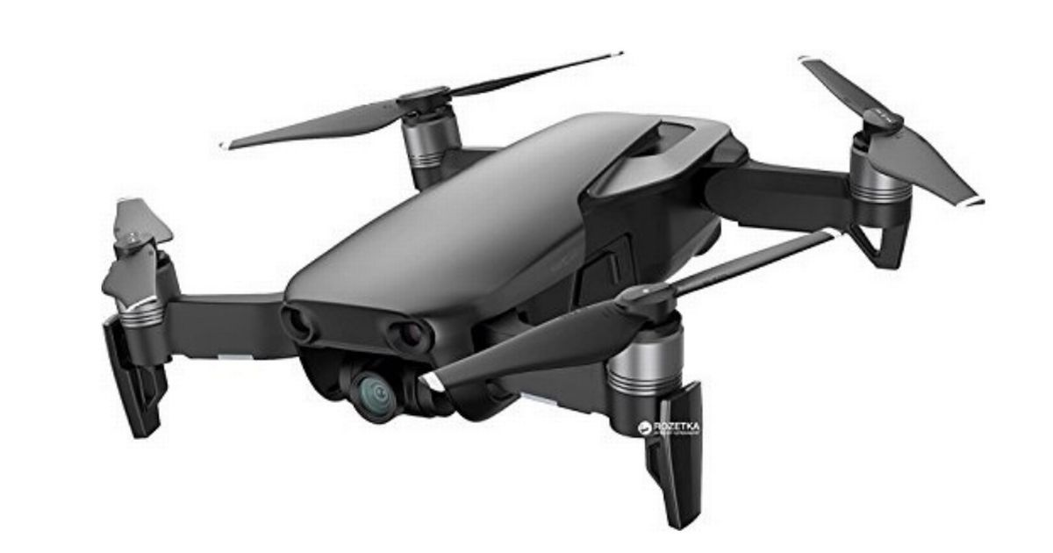
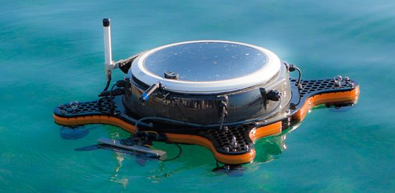
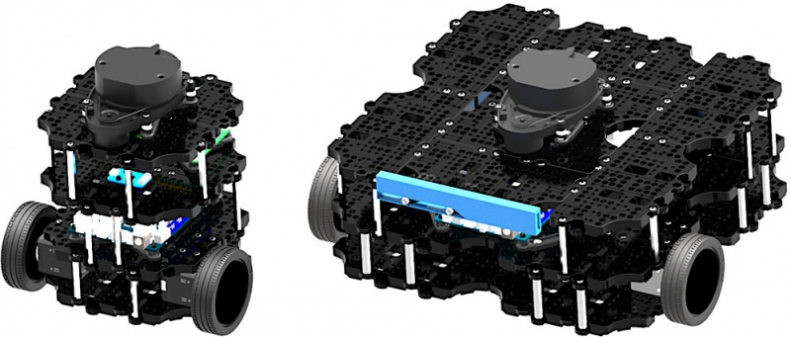
Unmanned vehicles ~future of IOT
Environmental Monitoring
Disaster Management
Agricultural Application
Traffic Monitoring
Weather Monitoring
Search & Rescue
Not static
Deployable
Carry flexible Payloads
Can be re-programmable
Can measure anything
ΙοΤ
Notes:
The use of unmanned vehicles is rising in areas of everyday
life such as environmental monitoring [1], agricultural
applications, disaster management, regardless of the domain
that they belong to, i.e., aerial, ground or underwater. The
characteristics that made them so popular are their degree of
autonomy, i.e., the ability to make decisions without human
intervention, the endurance and the payload they can support.
As drones become more advanced they present greater value
for commercial business use especially in case of mobile
security monitoring or supporting crisis management activities.

Slide 4
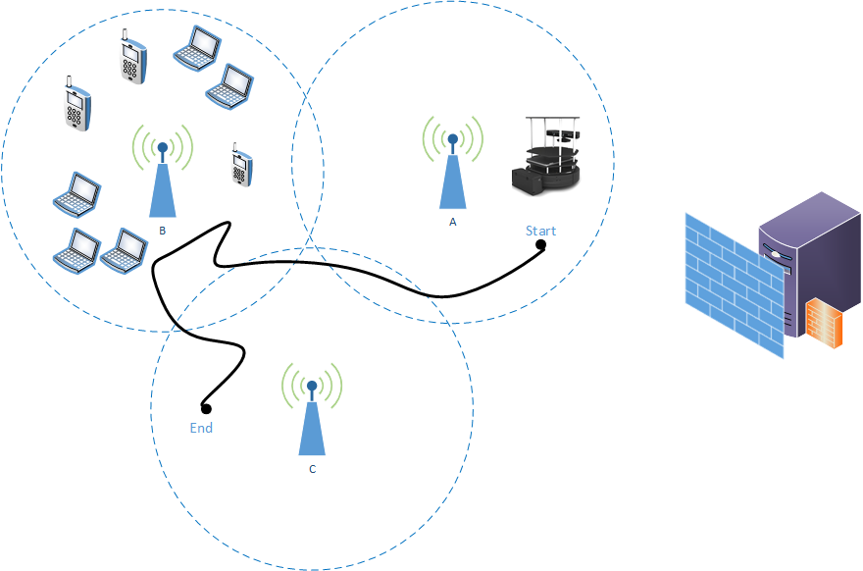
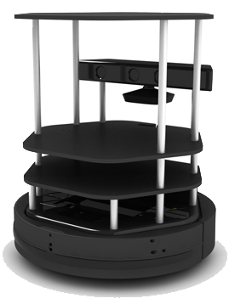
ONE EXAMPLE (1/2)
Use of unmanned ground device (UGV)
  equipped with video camera
  Sensors of Temperature Humidity
  GPS
  Network Interface
  Where? Unknown Area
Goal: the successful execution of a mission.
Notes:
One example is the use of umnanned flying device,

Slide 5
ONE EXAMPLE (2/2)
Mission
  is trajectory with specific way-points
  UxV is ordered to approach and gather various
    Sensors or images
  Ground Control Station (GCS)
    terrestrial system,
    coordinator/master node at distance
Notes:
A mission is often described as a trajectory with specific way-points in which the UxV is ordered to approach and
gather various measurements from sensors or images from Cameras
A Ground Control Station (GCS) is the terrestrial system, which acts as a coordinator/master node at distance
responsible for data acquisition and transmission. The communication between the UxV and the GCS is established via
wireless communications. A mission is created by the users and, then, GCS is responsible for the successful execution
of the mission autonomously.
GCS control messages shall be delivered with a high assurance of low or minimal time delay to enable real-time management, monitoring, control, and feedback loops. Enable real-time management, monitoring, control, and feedback loops.

Slide 6

Problem Definition (1/2)
Requirements of real time monitoring and control
  Messages delivered with high accuracy and Minimal delay
  GCS can continuously sends commands without any stop.
Restrictions
  The communication between the UxV and the GCS is established via wireless communications.
  No assurance
Notes:
The quality of the network has high importance for the mission because significant commands or sensor values can be lost. We can assume that even if control feedback is
in high priority, telemetry can be paused for short time in need of crisis. When the quality of network changes,
UxV/GCS can decide on-line to act accordingly in order not to overload a saturated network.
Network is important

Slide 7
Problem Definition(2/2)
Requirements of real time monitoring and control
  Messages delivered with high accuracy and Minimal delay
  GCS can continuously sends commands without any stop.
Restrictions
  The communication between the UxV and the GCS is established via wireless communications.
  No assurance
In uncertain wireless links – how secure that messages will be delivered from to GCS and the mission will be completed?

Slide 8
Contribution
We propose a model of on-line control unit adaptive to changes in network quality statistics by dynamically pause control telemetry and control messages based on an Optimal Stopping rule in order to ensure the optimal delivery of critical information:
an on-line network quality change detection mechanism,
an OST rule for time-optimized change detection,
comprehensive performance evaluation of our mechanism

Slide 9
Change Point Detection Theory
Xt
Data series = runtime network statistics.
Applied in Controller/UxV strategy
t1
t2
Identify a change in the data sequence or in distribution
  generally change in distribution
Change-point detection has its origins almost sixty years ago in the work of Page, Shiryayev, and Lorden
Notes:
Change-point detection has its origins almost sixty years
ago in the work of Page [14], Shiryayev [15], and Lorden
[16], who focused on sequential detection of a change-point
in an observed stochastic process. The stochastic process was
typically a model for the measured quality of a continuous
production process, and the change-point indicated a deterioration
in quality that must be detected and corrected

Slide 10
Quality Network Indicator -QNI (1/3)
Quality Network Indicator - normalization
  the SNR
  Quality Indicator
Notes:
is derived by the normalization of two important network metrics: the SNR and Quality Indicator. Quality indicator is exported by an access point in scale [0,100] and depends on on the level of contention or interference, like the bit or frame error rate, or other hardware metric.

Slide 11
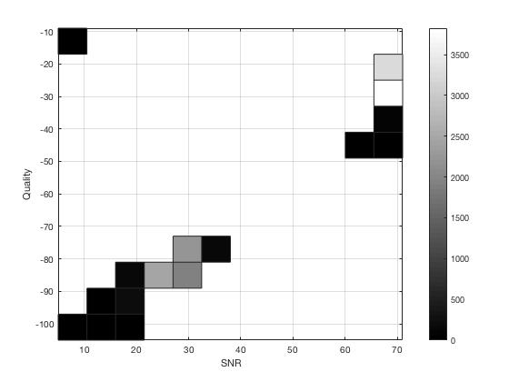
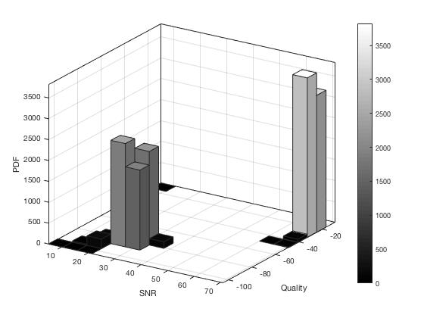
Quality Network Indicator–QNI (2/3)
Change Point Detection Theory
Notes:
he possible states of our analysis are (a) good SNR - good Quality, (b) good SNR - poor Quality, (c) poor SNR - good Quality, and (d) poor SNR - poor Quality. As shown in Figure \ref{fig:SATD1}, our problem can be defined as binary in which the 'good SNR - poor Quality' and 'poor SNR - good Quality' states are not dominant and can be considered as a subset of ' poor SNR - poor Quality' state. Therefore the change detection problem is approached by Page's \cite{page54} introduced method of cumulative sum change detection algorithm with among two states $f_{0}$ and $f_{1}$.

Slide 12
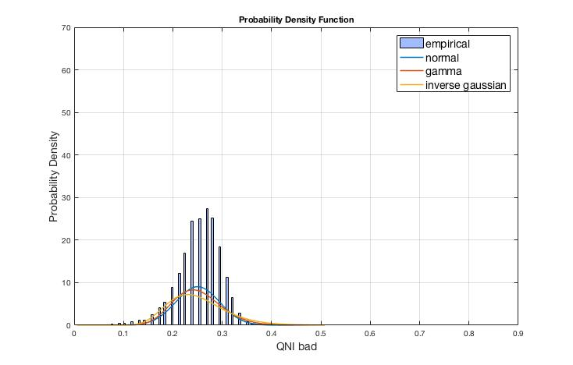
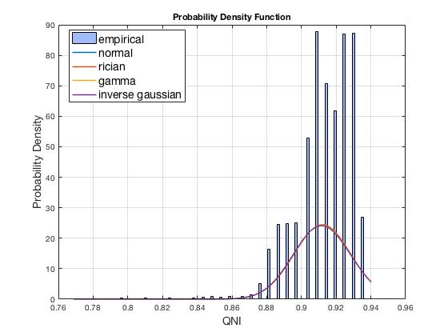
Quality Network Indicator–QNI (3/3)
Probability Distributions of QNI in poor and good network conditions
Notes:
The chosen method returns the model fitting of all the
parametric probability distributions to the SNR and compare
them graphically as shown in Figure 2a for f0 and Figure 2b
for f1 .
Based on these observations, we model f0 and f1 through
the Normal distribution.

Slide 13
Change Point Detection Theory -Prerequisites
Let us assume that network readings Χ_{1,} Χ₂,…, Χ_{n} are independent and identically distributed (i.i.d.) random variables and are observed sequentially in real time.
Known probability density functions f₀ and f₁, where f₀ f₁
We are interested in finding stopping time that detects a change from one distribution to another with the minimum delay based only on the realization of the random values x_{0,} x_{1,…} x_{n}

Slide 14
Change Point Detection Theory Solution
The optimal solution to was proved by that it is given by the Cumulative Sum (CUMSUM) test proposed by Page . Hence the optimal stopping time is given by:

Slide 15
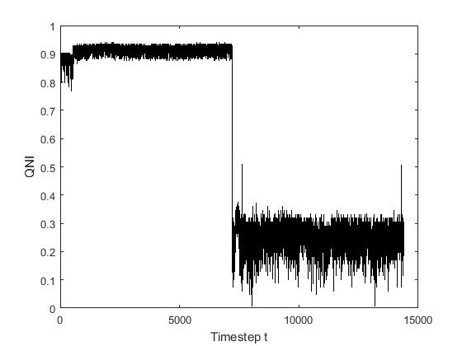
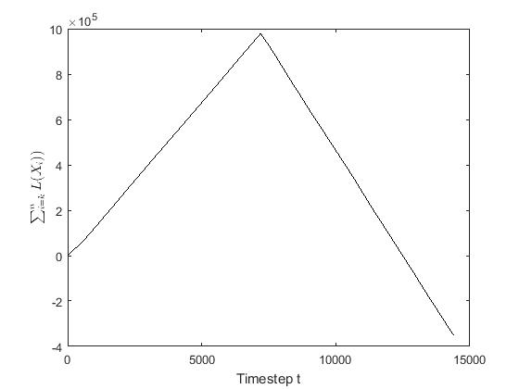
The behavior of the cumulative log-likelihood ratio corresponding to a change.

Slide 16
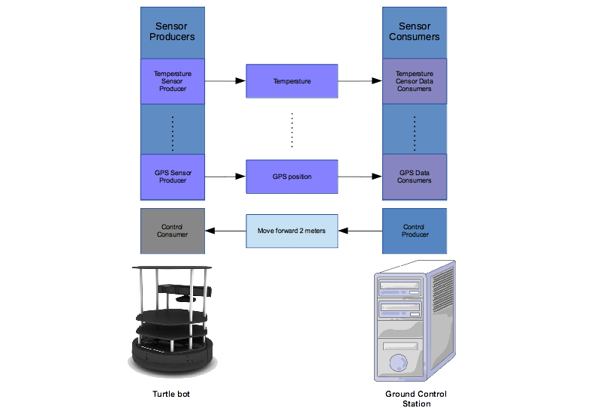
Simulation Setup
UGV is using ROS Platform
A GCS is a fixed server communicating with a moving UGV.
GCS initializes a mission of an UGV following a specific trajectory.
UGV during the mission sends back to GCS telemetry messages from its on board sensors, like health status, battery, temperature and video streaming.
UGV is in outdoor facility faces saturated network conditions.
Notes:
. The mission contains a sequence of way-points in an outdoor infrastructure which are being sent to UGV with specific control messages. These commands are produced by following the exponential distribution

Slide 17
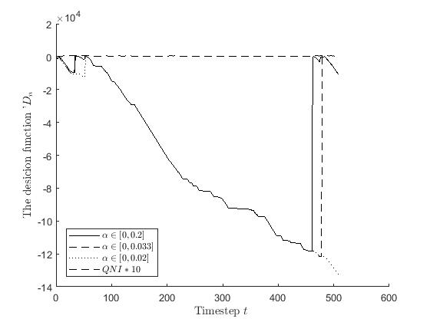
Analysis of simulation parameters
Different values of α values were evaluated by the number of the false alarms detected in N-100 executions of the mission.
A values were generated randomly
lower the α values the performance of FAR reaches better scores.
Notes:
However for values lower than $0.01$ the experiment can gain similar values. The chosen interval is the $[0,0.002]$. This is can be shown in Figure \ref{fig:D_t}, in which the function $D$ based on different values of $\alpha$ is compared. The changes of network based on SNR is presented in the same figure -the initial QNI values were multiplied by 100 in order to be readable.

Slide 18
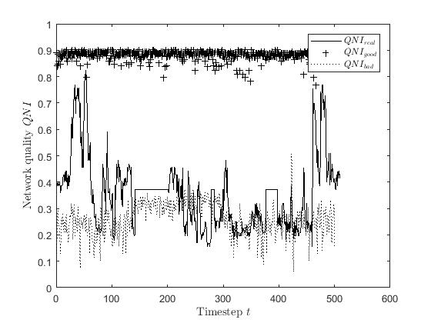
Performance evaluation
A non policy model
  GCS and Ux\GV continuously send and receive messages having indifference to network conditions
A heuristic threshold-based mode
  the transmission of messages is paused when QNI falls under the interval of [0.2,0.3] and messages are stored in a queue.
OST model with α values in [0,0.02]
OST model with α values in [0,0.01]

Slide 19
Total Produced and Consumed Packets
No policy & Heuristic ~24% lost messages
OST α=0.01 ~ 4%
OST α=0.002~2%

Slide 20
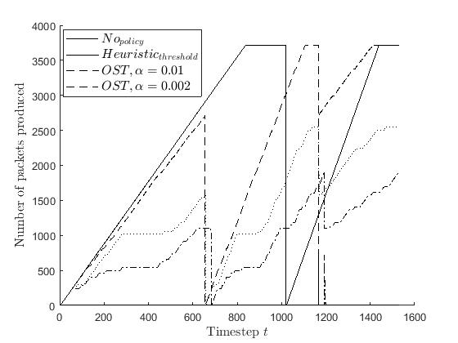
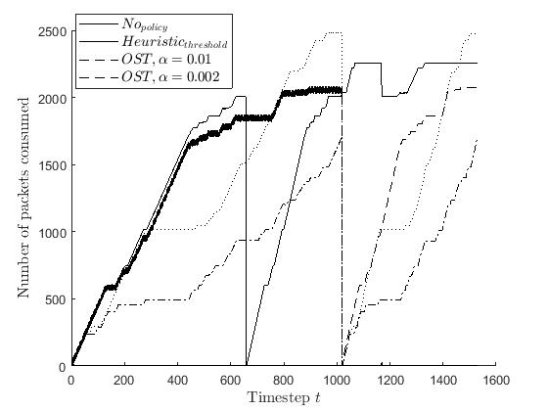
Produced and Consumed data
Notes:
n overview of the messages produced and consumed by the four different models. It is expected that "network-agnostic" models produce a great amount of exchanged models and especially in threshold model the messages are displaced due to the latency of queue. In case of OST models, producers and consumers have a more moderate and normal distribution of messages in time hence the messages are delivered even if the existence of network disconnections.

Slide 21
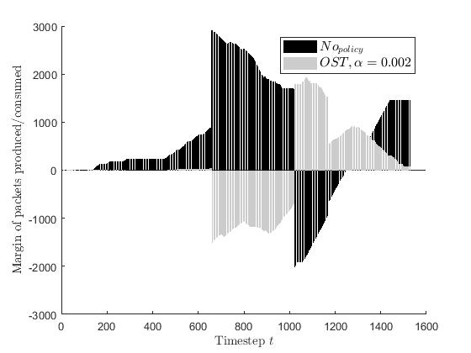
Latency Detected
This latency imported by the stopping time of the producers is balanced in the next time steps and finally close to all messages are delivered successfully.
This is not the case for the original model in which the producers continually and burdens the network and consumers with messages that re not delivered.
Notes:
The difference in each timestep of the messages produced and consumed by the two units is studied in the main cases, i.e. in the original case where no algorithm is implemented and in the case of the OST model. It should be noted that we have 3 main network disconnections in the timestep $t=600$, $t=1000$ and $t=1200$. Until $t=600$ the OST model, although it works in saturated network, the differences between the produced and consumed messages are zero. After the first disconnection it can be noticed a small shift of the messages paused and consumed in a later time

Slide 22
Conclusions and Future Work
Framework that monitors network conditions and changes the UxV transmission of control message and telemetry trying
  not to overload the network in which the devices operate and move.
  Model of dynamic decision making, adaptive to changes in network conditions, by dynamically adjusting the transmission of control messages and telemetry based on an optimal stopping rule
  . The performance evaluation showed the successful delivery of messages in poor network conditions and the moderate production of messages so as not to burden an already saturated network.
Our future agenda includes a time-constraint approach with an additional OST problem of finite horizon in order to include a trade-off for the 'pausing' strategy.

Slide 23

Questions

Slide 24
References
M. Dunbabin and L. Marques, “Robots for environmental monitoring: Significant advancements and applications,” Robotics & Automation Magazine, IEEE, vol. 19, no. 1, pp. 24–39, 2012.
A. B. McDonald, “Survey of adaptive shortest-path routing in dynamic packet-switched networks,” Technical report at the Dept of Information Science and Telecommunications, April 1997.
S. M. Y. X. I. C. M. Chen, V. Leung, “Hybrid geographical routing for lexible energy-delay trade-offs,” IEEE Trans. Veh. Technol, vol. 58, no. 9, pp. 4976–4988, 2009.
Y. Cao and Z. Sun, “Position based routing algorithms for ad hoc networks: A taxonomy,” Ad Hoc Wireless Networking, Kluwer, 2003.
F.Fu and M. van der Schaar, “Dependant optimal stopping framework for wireless multimedia transmission,” in Accoustics speech and SignalProcessing (ICASSP). IEEE, 2010, pp. 1–6.
K. Kolomvatsos, C. Anagnostopoulos, “In-network decision making intelligence for task allocation in edge computing.” in ICTAI, 5-7 Nov 2018,Volos, 2018.
K. Anagnostopoulos, C. Kolomvatsos, “Predictive intelligence to the edge through approximate collaborative context reasoning,” Applied Intelligence, vol. 48, no. 4, p. 966991, 2018.
C. Harth, N. Anagnostopoulos, “Edge-centric efficient regression analytics.” in EDGE 2018, CA, 02-07 Jul 2018, 2018.
C. Anagnostopoulos and S. Hadjefthymiades, “Delay-tolerant delivery quality information in ad hoc networks,” Journal of Parallel and Distributed Computing, vol. 71(7), pp. 974–987, 2011.

Slide 25
References
“Optimal quality-aware scheduling of data consumption in mobile ad hoc networks,” Journal of Parallel and Distributed Computing, vol. 72(10), pp. 1269–1279, Oct. 2012.
T. S. Ferguson, Optimal Stopping and Applications. Mathematics Department, UCLA, Accessed May, 2018.
K. Panagidi, C. Anagnostopoulos, and S. Hadjiefthymiades, “Optimal grouping-of-pictures in iot video streams,” Computer Communications - In press, 2017
C. Anagnostopoulos and S. Hadjiefthymiades, “Advanced principal component-based compression schemes for wireless sensor networks,” ACM Trans. Sen. Netw., vol. 11, no. 1, pp. 7:1–7:34, Jul. 2014.[Online]. Available: http://doi.acm.org/10.1145/2629330
E. S. Page, “Continuous inspection schemes,” Biometrica, vol. 41, pp. 100–115, 1954.
A. N. Shirayaev, “Optimal stopping rules,” Springer-Verlag, 1978.
E. S. Page, “Procedures for reacting to a change in distribution,” Ann. Math. Statist., vol. 42, no. 6, pp. 1897–1908, 1971.
V. J. Unnikrishnan and S. Meyn, “Least favorable distributions for robust quickest change detection,” in 2009 IEEE International Symposium on Information Theory , IEEE, 2009.
G. V. Moustakides, “Optimal stopping time for detecting changes in
distributions,” Ann. Statist., vol. 14, no. 4, pp. 1379–1387, 1986.

Slide 26
Change Point Detection Theory - Prerequisites
Stopping Rule is defined by two objects
A sequence of random variables, X₁, X₂, .., whose joint distribution is assumed known
A sequence of real-valued reward functions,
        y₀, y₁(x₁), y₂(x₁,x₂), …, y∞(x₁,x₂,…)
Given these objects, the problem is as follows:
You are observing the sequence of random variables, and at each step n, you can choose to either stop observing or continue
If you stop observing, you will receive the reward y_{n}
You want to choose a stopping rule Φ to maximize your expected reward (or minimize the expected loss)

Slide 27
Change Point Detection Theory - Prerequisites
Stopping rule Φ consists of sequence
        Φ = (Φ₀, Φ₁(x₁), Φ₂(x₁,x₂), …)
Φ_{n}(x₁,…,x_{n}) : probability you stop after step n
0 <= Φ_{n}(x₁,…,x_{n}) <= 1
If N is random variable over n (time to stop), the probability mass function ψ is defined as

Slide 28
Change Point Detection Theory - Prerequisites
so, the problem is to choose stopping rule Φ to maximize the expected return, V(Φ ), defined as
j = ∞ if we never stop (infinite horizon)
j = T if we stop at T (finite horizon)

Slide 29
Change Point Detection Theory
A sequential change point detection rule is derived by stopping time τ of the observation stream.
The stopping time τ is the output of two different characteristics:
the detection delay and Dn
the frequency false alarm FAR
Under the Lorden criterion, the objective is to find the stopping rule that minimizes the worst-case delay subject to an upper bound on the false alarm rate.

Slide 30
Robot Operating System (ROS)
Meta Operating System
Open source
Code Reuse
Widespread use

Slide 31
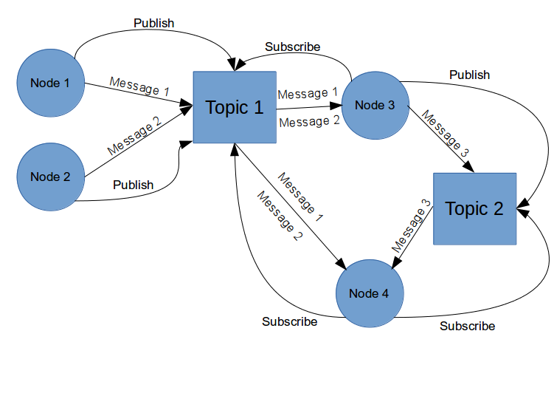
Robot Operating System (ROS):
Publish Subscribe
Publishers
Subscribers
Topics

Slide 32
Robot Operating System (ROS):
Sensors
1D range finders
2D range finders
3D Sensors (range finders and RGB-D cameras)
Audio / Speech recognition
Cameras
Environmental (like measuring wind speed and direction)
Force / Torque / Touch Sensors
Motion Capture
Pose estimation (GPS / IMU)
Power Supply
RFID (Radio-frequency identification

